Slide 1



“All applicants matter” 2021
Posting an advert to fill a role will flood you with applications making the best candidates hard to find.
Is there a better way to:
Choose the right shortlist?
Positively communicate & interact with candidates?
Protect your brand against claims through the process?
We measure – Facts, Figures, Experience, IQ & EQ
www.recruitment-tests .co.uk

Slide 2

Problem and Solution ?
In 2020, we typically saw >400 applicants for roles < £25k
To provide a suitable shortlist, we can automate the CV shortlist process by:
Loading up to 100 qualifying questions / criteria for the role from your job specification and sending to all applicants in a single batch
Calculating a candidate % relevance score, giving you the top 10
Table of quantitative highlights enables further qualitative judgement
You can now evidence a fair and objective shortlist without any bias
All for an affordable price

Slide 3
A little help from us in 2021
Introduction offer
To quickly help you with candidate shortlisting in this difficult time we offer a special price single upload option
  With one file we send 1 or 2 tests to all you applicants for a significantly reduced price
  One off applicant/candidate list of 100 to 500 emails
After immediate and automatic marking. You can then access a table of results on our portal and decide on the cut off points for next stage etc.
Sign up for a free look here …. https://www.recruitment-tests.co.uk/site/html/freetrial.php ….

Slide 4


The Keys to Success

Slide 5
What are the alternatives?
After your advert(s) to fill a role you may typically have to:
Spend 4 hours manually scanning each CV (400 candidates at 30 seconds each)
Spend many more hours speaking with potentially irrelevant candidates who’ve called you
Miss the most relevant candidates buried in the haystack
Lose time and clarity because of the applicant volume
Potentially deal with candidates who’ve claimed an unfair process.

Slide 6

So the choice
available to you is clear.

Slide 7





Swift process risk-free
STEP 1: E- mail us jesse.lawson@recruitment-tests.co.uk or visit www.recruitment-tests.co.uk
STEP 2: Choose tests & other relevant services and supply candidate email list?
STEP 3: Tell us invoice details – pay half before send and half after within 7 days
STEP 4: Check the results/benchmarking part of the portal, drop the table to Excel
STEP 5: Review only the CVs of the best IQ and/or detailed relevance SAVE TIME

Slide 8
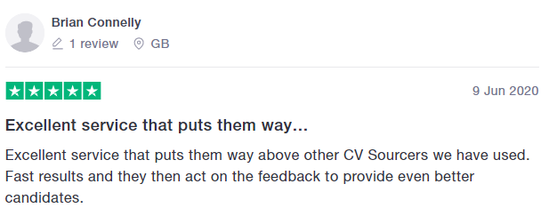
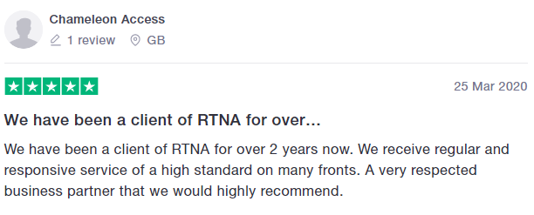
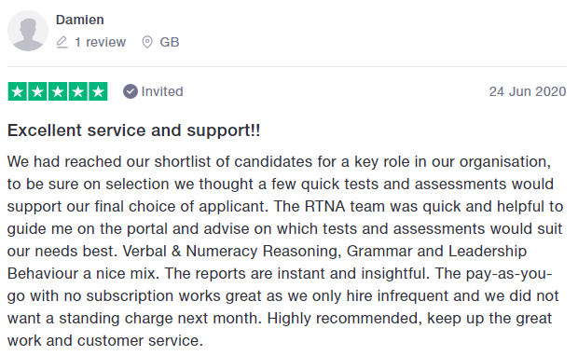
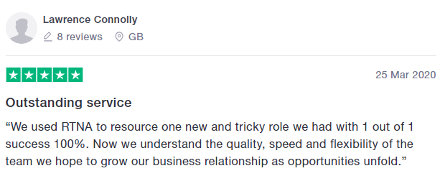
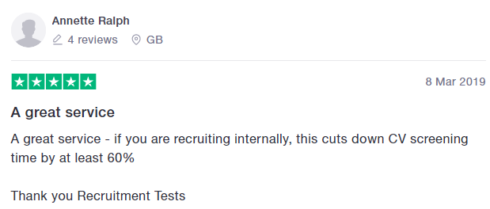
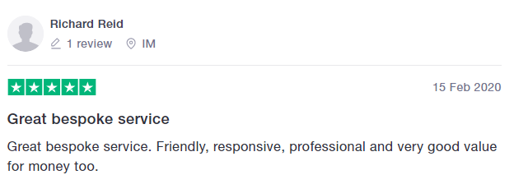
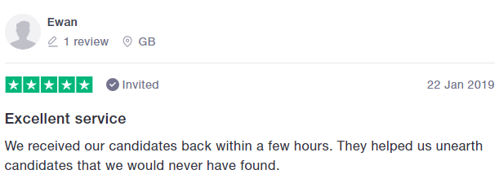
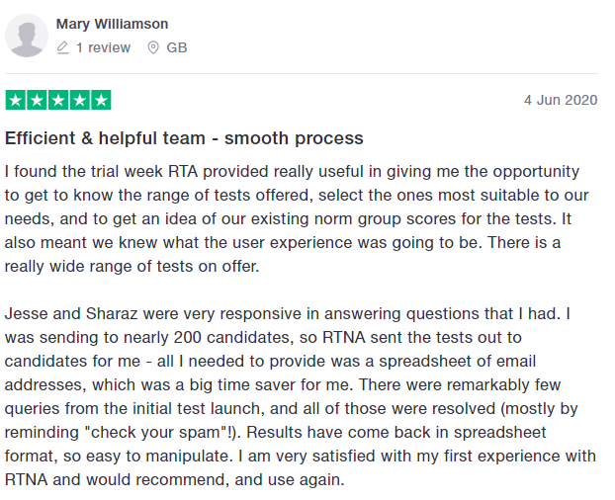
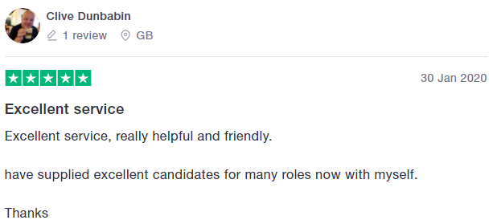
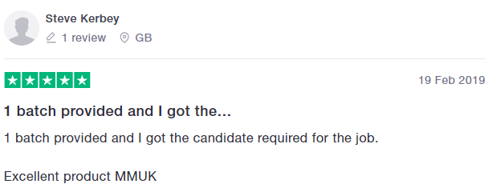
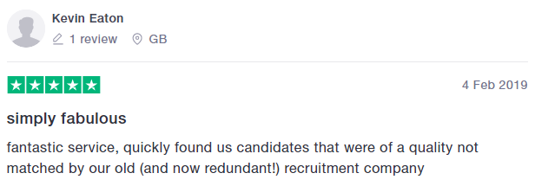
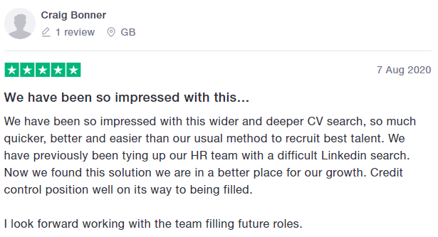
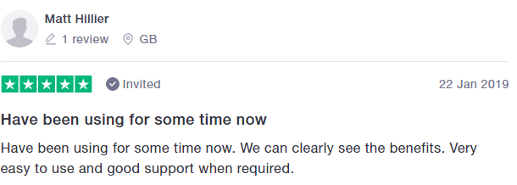
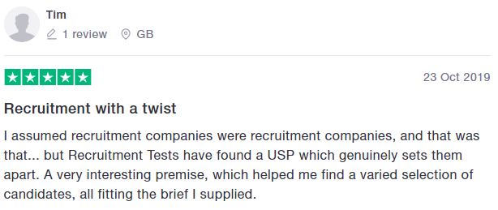
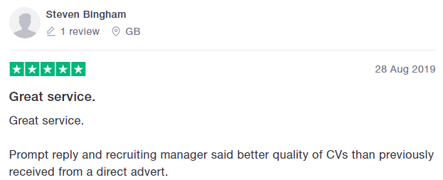
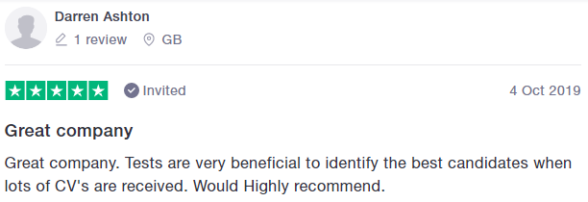
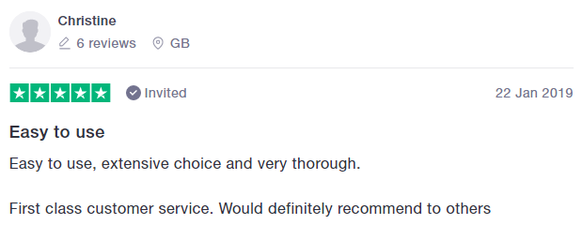
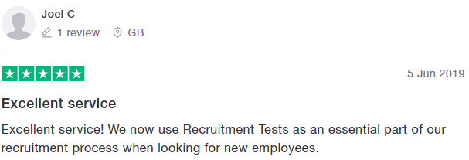

Slide 9

Prices – One off mass uploads
£1.00 + VAT per test
100-500 Candidates
Facts / Figures / Experience / Relevance IQ / EQ
Cap £375 + VAT

Slide 10

www.recruitment-tests.co.uk
Who we are
Team of 20
Jesse – 25 years in Recruitment
https://www.linkedin.com/in/jesse-lawson-a545874b/
Karen – 22 years in Recruitment
https://www.linkedin.com/in/karencalver/
Susan – 30 years in Recruitment
https://www.linkedin.com/in/susan-cuff/
Sharaz – Accountant previously of Tax Assist
https://www.linkedin.com/in/sharaz-ahmad-0b995662/

